Slide 1
Totally a video
Josh Grillo

Slide 2
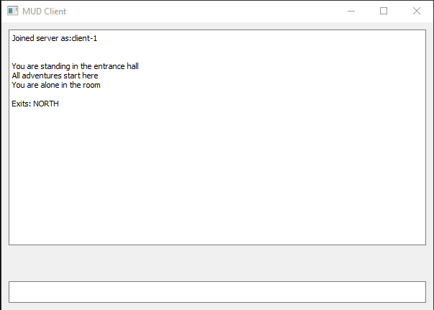
Artefact
My computing artefact is a simple Multi User Dungeon, with a basic window as its interface.
Multiple players can be in the dungeon at once, and interact with others and their surroundings.

Slide 3
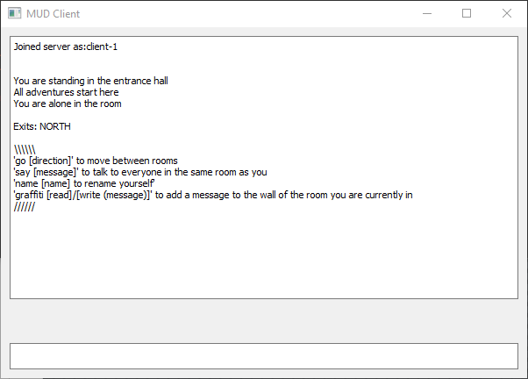
INput
Inputs are done by typing in commands into the box at the bottom. The following appears when typing ‘help’.
As it is currently, The Dungeon is a glorified chat room.

Slide 4
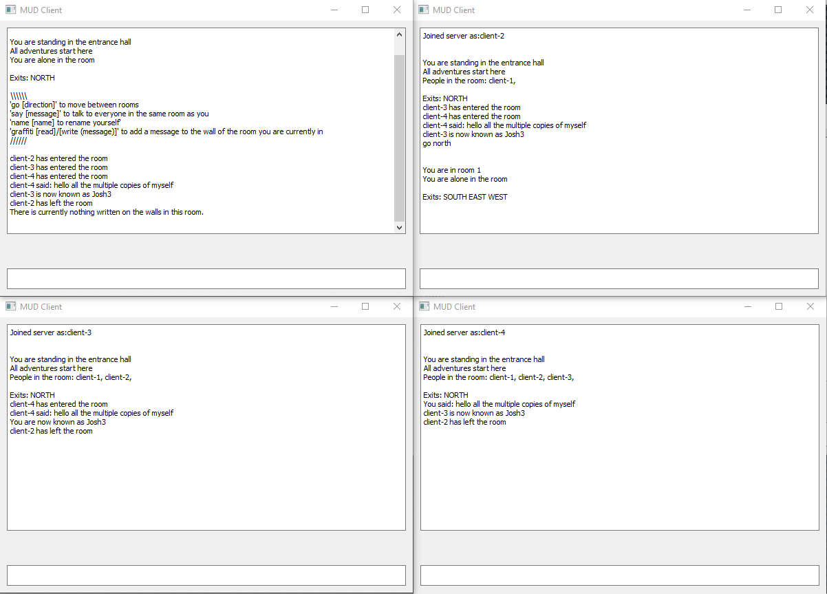
Multiple Users
Multiple users can all join the dungeon, and interact individually. Other users are informed as to the actions of the other users.
The following commands have been used in this demonstration;
Client-4 : “say [message]”
Client-3 : “name [name]”
Client-2 : “go [Direction]”
Client 1 : “Graffiti Read”

